Slide 1
Physics Informed Neural Networks (PINNs)
Paht Juangphanich, Ezra McNichols, Kyle Monaghan, Arman Mirashemi

Slide 2

Timeline
1990s: Proof was made to show Neural Networks can be used to solve PDEs
Lagaris, I. E., Likas, A., & Fotiadis, D. I. (1998). Artificial neural networks for solving ordinary and partial differential equations. IEEE transactions on neural networks, 9(5), 987-1000.
1998-2019: Conventional PINNs, solving PDE without discontinuity
2019-Present: Research into solving discontinuous PDEs
Michoski, C., Milosavljević, M., Oliver, T., & Hatch, D. R. (2020). Solving differential equations using deep neural networks. Neurocomputing, 399, 193-212.
Patel, R. G., Manickam, I., Trask, N. A., Wood, M. A., Lee, M., Tomas, I., & Cyr, E. C. (2022). Thermodynamically consistent physics-informed neural networks for hyperbolic systems. Journal of Computational Physics, 449, 110754.
Papados, A. Solving Hydrodynamic Shock-Tube Problems Using Weighted Physics-Informed Neural Networks with Domain Extension.

Slide 3
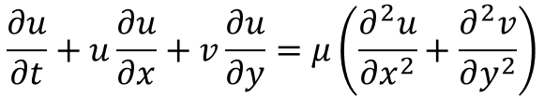
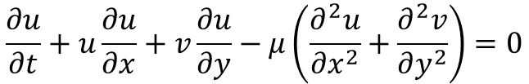
Conventional PINNs and how they work (High Level)
Example Burgers Viscous Equation:
$$\frac{∂u}{∂t}+u\frac{∂u}{∂x}+v\frac{∂u}{∂y}=μ\left(\frac{∂^{2}u}{∂x^{2}}+\frac{∂^{2}v}{∂y^{2}}\right)$$
Dissipation
Y
Multi-Layer Perception
$$\frac{∂u}{∂t}+u\frac{∂u}{∂x}+v\frac{∂u}{∂y}−μ\left(\frac{∂^{2}u}{∂x^{2}}+\frac{∂^{2}v}{∂y^{2}}\right)=0$$
X
Model
Inputs: t, x, y
Outputs: u, v
PDE Loss
Domain Sampling
(Inputs: t, x, y)
Optimize Model weights

Slide 4
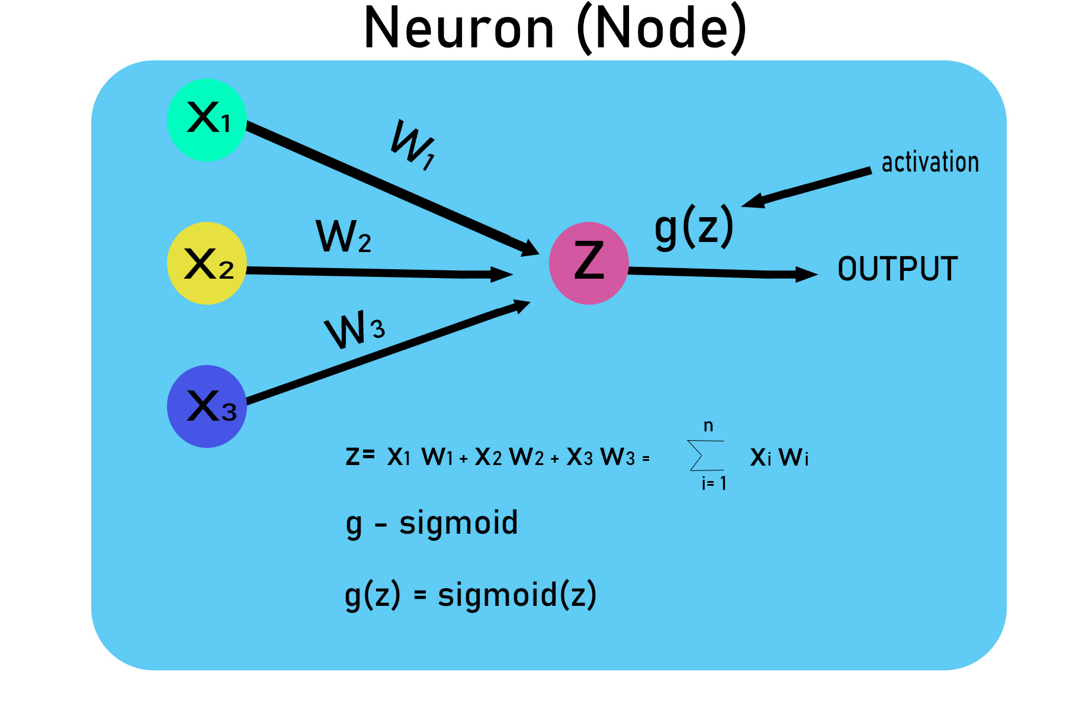
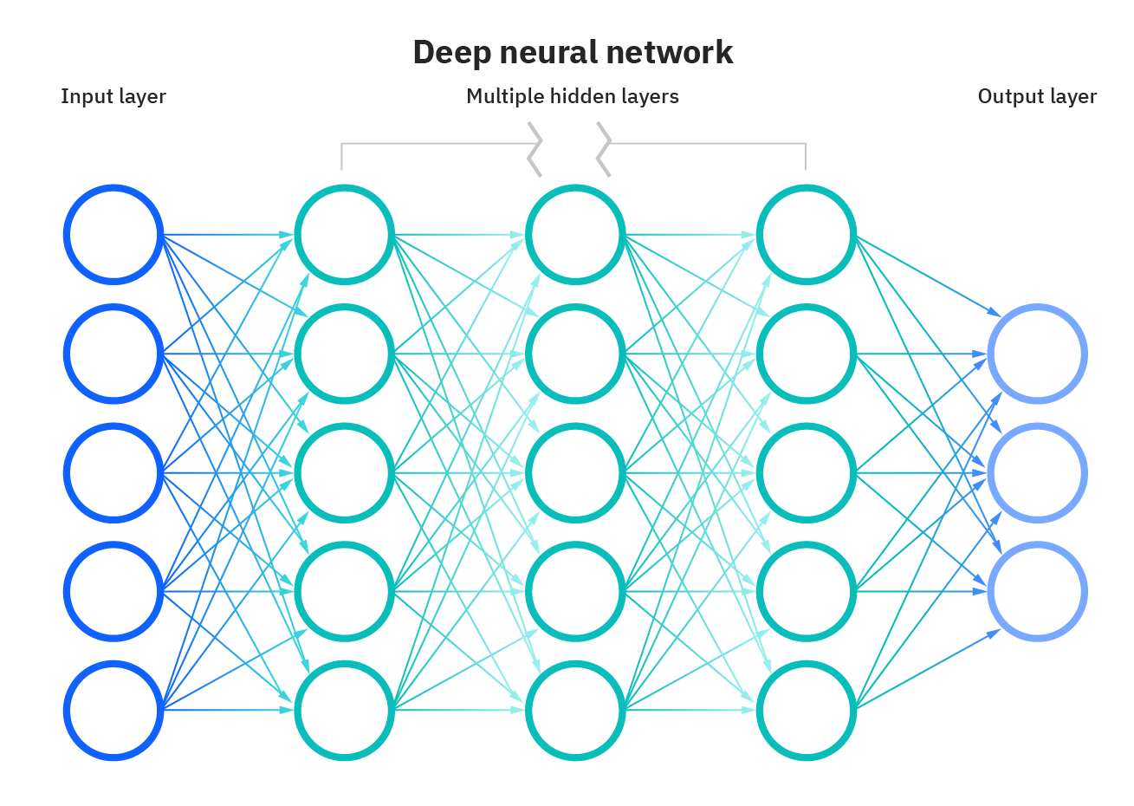
Conventional PINNs and how they work (MLP Detail)
= Tanh(z)
Inputs: x, y, t
Outputs: u, v

Slide 5
Conventional PINNs and how they work (PDE Loss Detail)

